Slide 1
Monitoring particle and exosome count of cancer patient plasma post treatment
Pres. By Nareg Ohannesian

Slide 2
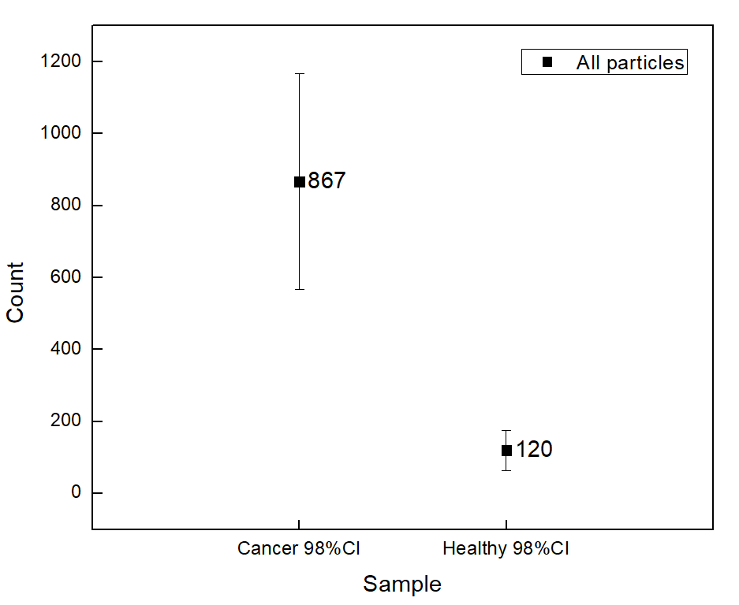
Combined all particle count (BW) of plasma samples

Slide 3
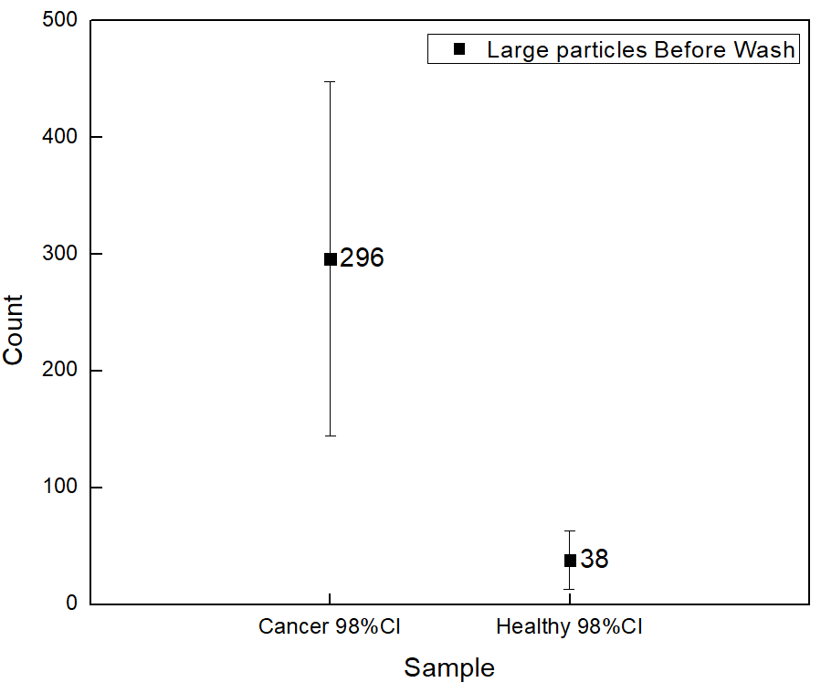
Combined Large particle count (BW) of plasma samples

Slide 4
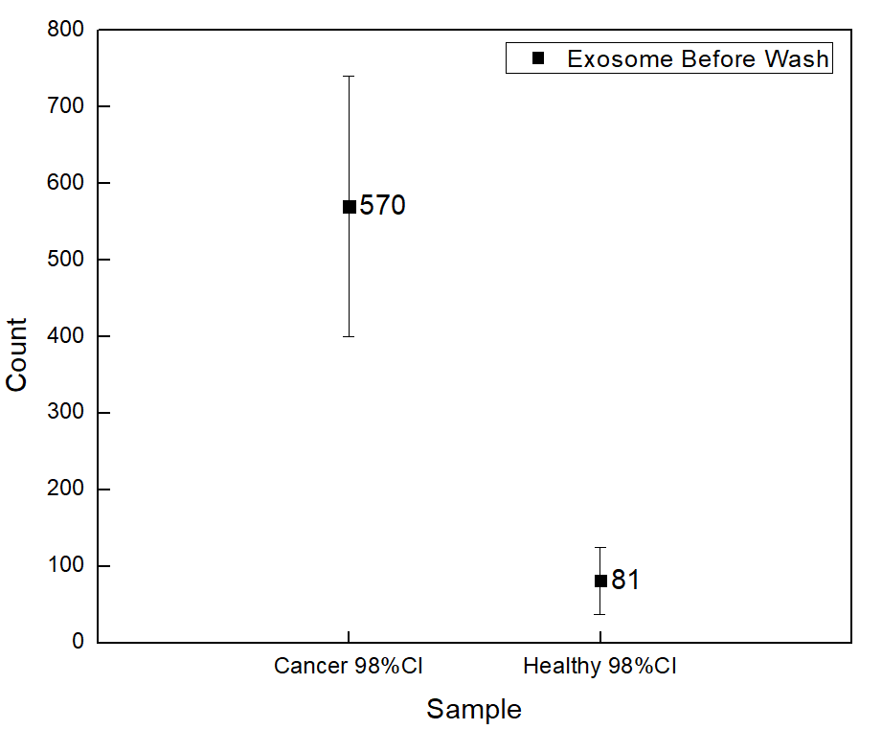
Combined exosome count (BW) of plasma samples

Slide 5
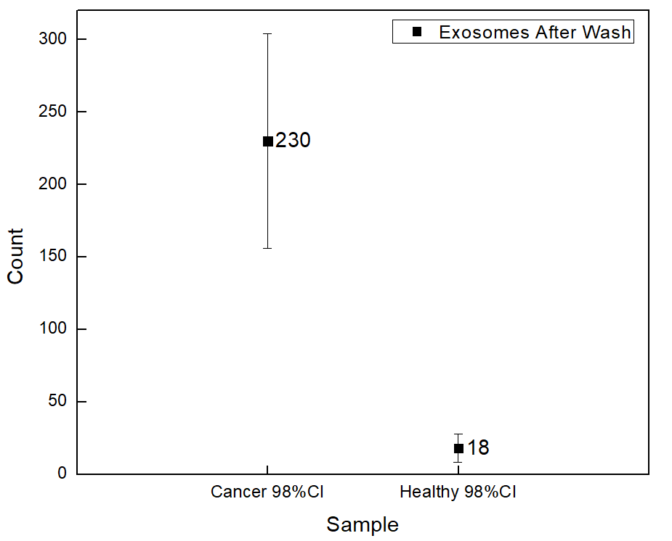
Combined exosome count (AW) of plasma samples

Slide 6
Experimental Details for post treatment plasma
Used samples: 1, 2, 3, 4, 5, 6, 7, and 9
Plasma volume: 20 µl.
Type of Cancer: unknown.
Concentration: unknown.
Size Distribution: unknown.
Experimental duration: 60 min.
Antibody used: CD9, CD81, and CD63.

Slide 7
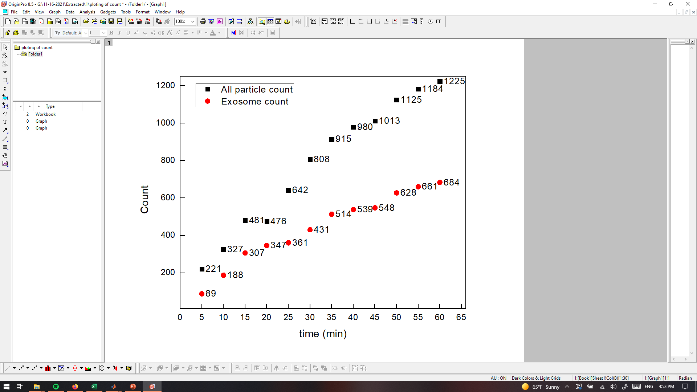
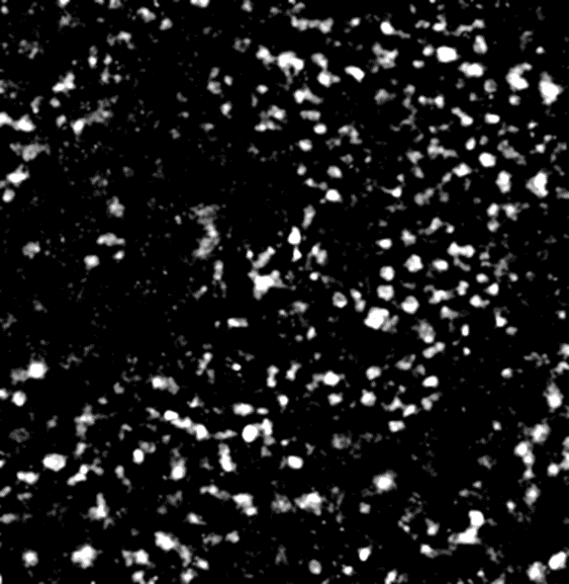
PANRORAMA of Plasma Sample 1 (similar to cancer plasma)
Time: 60 min
Count: 1225
Time: 60 min wash
Count: 428
Note: 36 % of captured exosome have positive response to miRNA-21
Scale bar: 10 µm

Slide 8
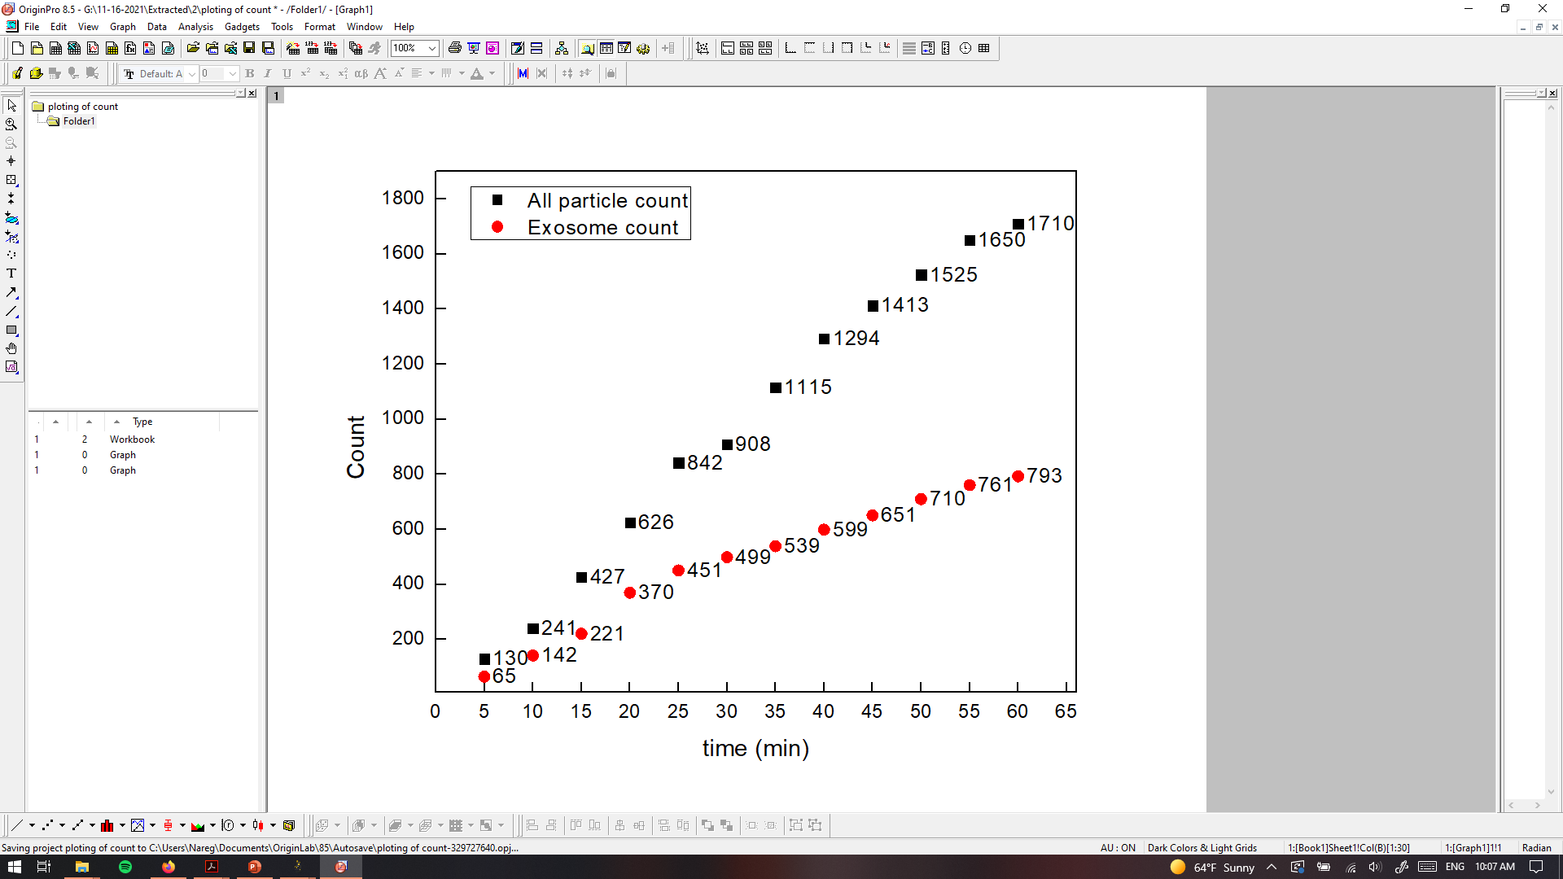

PANRORAMA of Plasma Sample 2 (similar to cancer plasma)
Time: 60 min
Count: 1710
Time: 60 min wash
Count: 292
Note: no response to miRNA-21 mb
Scale bar: 10 µm

Slide 9
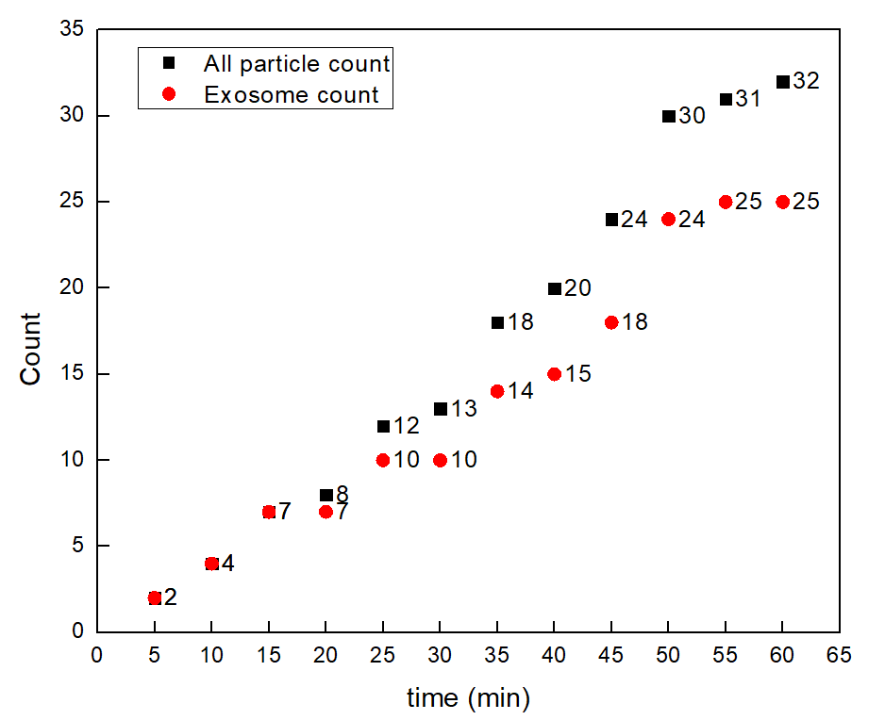
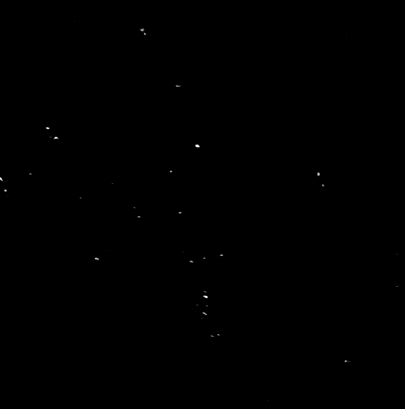
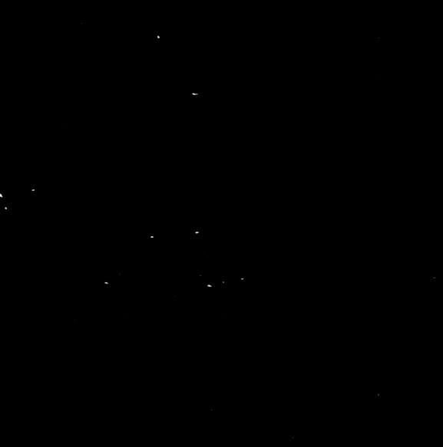
PANRORAMA of Plasma Sample 3 (similar to healthy plasma)
Time: 60 min
Count: 32
Time: 60 min wash
Count: 11
Note: No response to miRNA-21 mb
Scale bar: 10 µm

Slide 10
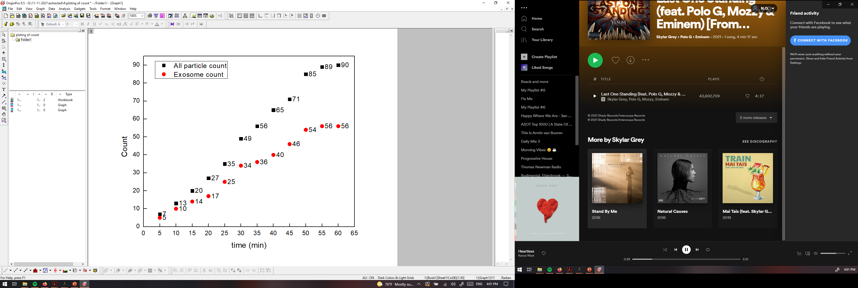

PANRORAMA of Plasma Sample 4 (similar to healthy plasma)
Time: 60 min
Count: 90
Time: 60 min wash
Count: 7
Note: No response to miRNA-21 mb
Scale bar: 10 µm

Slide 11
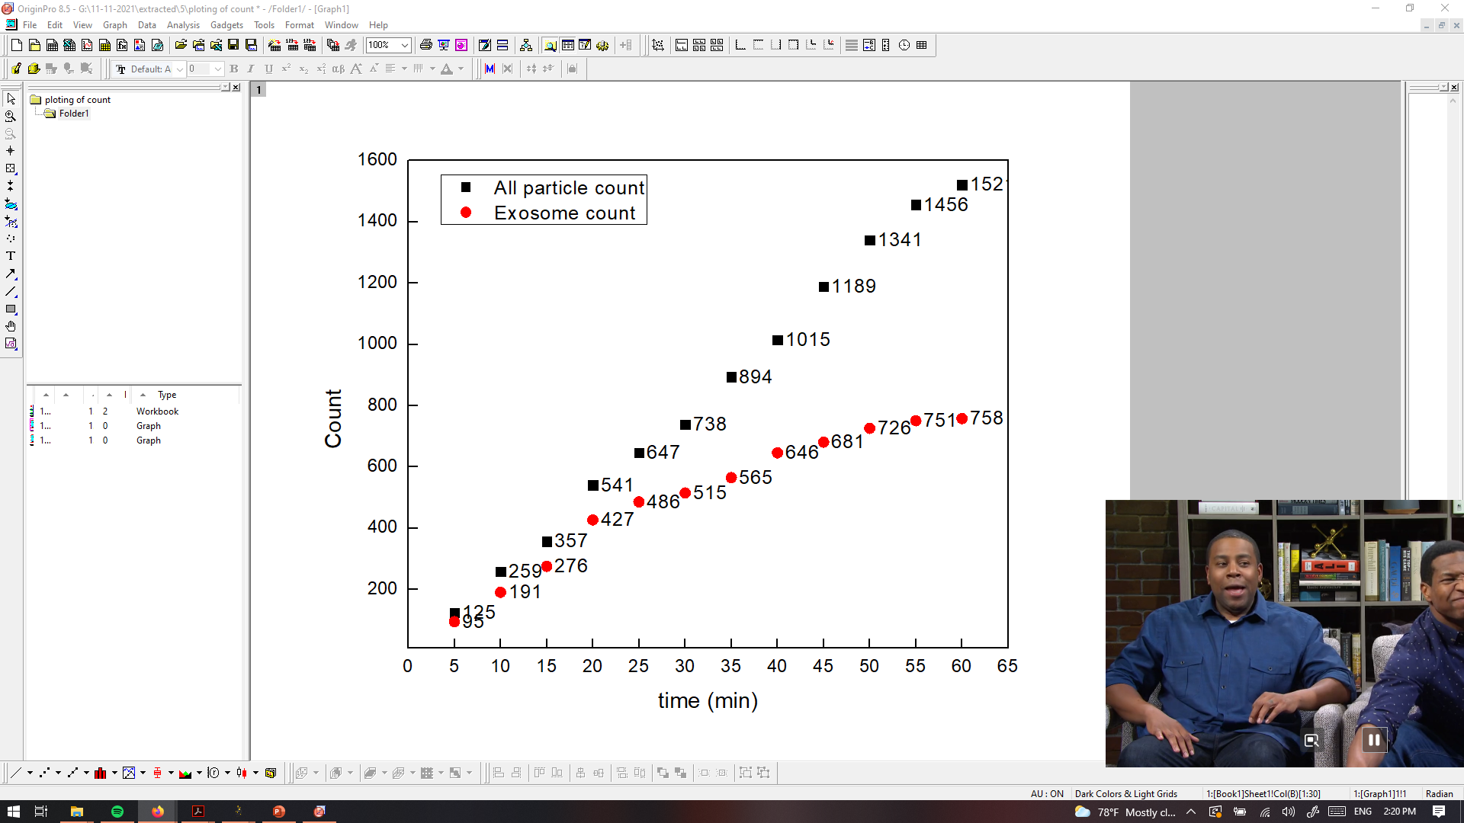

PANRORAMA of Plasma Sample 5 (similar to cancer plasma)
Time: 60 min
Count: 1521
Time: 60 min wash
Count: 431
Note: 15.3 % of exosome have positive response to miRNA-21
Scale bar: 10 µm

Slide 12
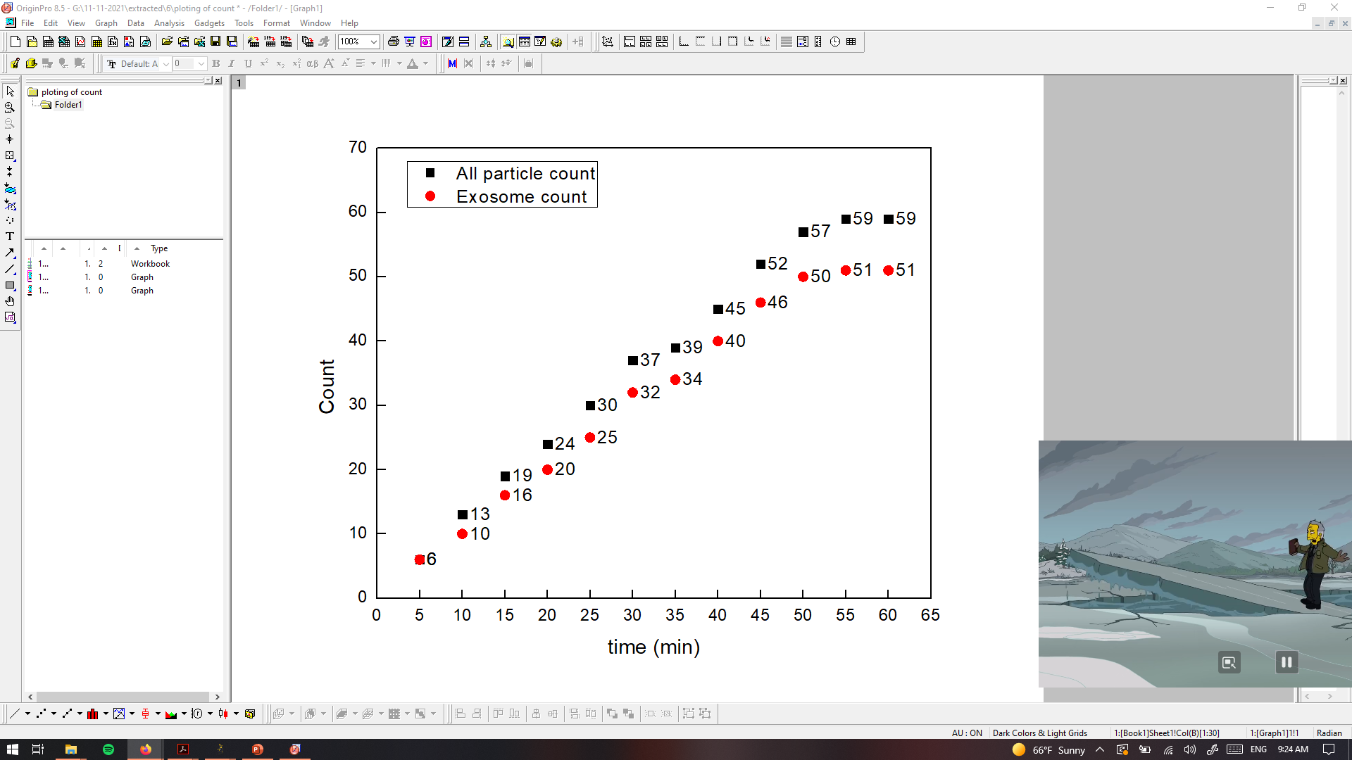
PANRORAMA of Plasma Sample 6 (similar to healthy plasma)
Time: 60 min
Count: 59
Time: 60 min wash
Count: 12
Note: No response to miRNA-21 mb
Scale bar: 10 µm

Slide 13
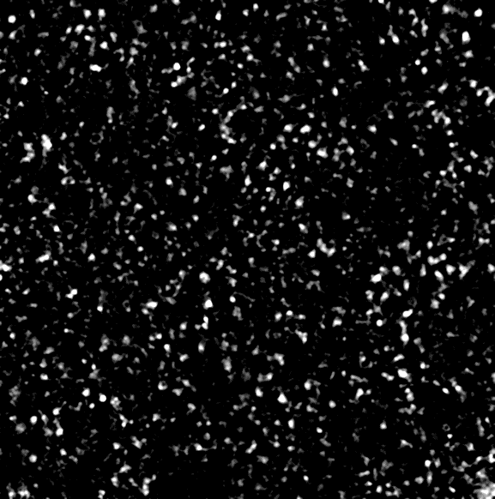

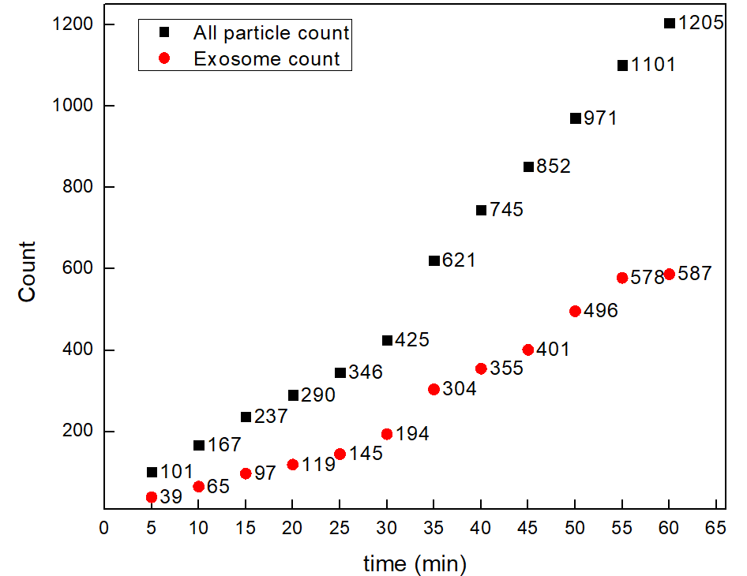
PANRORAMA of Plasma Sample 7 (similar to cancer plasma)
Time: 60 min
Count: 1205
Time: 60 min wash
Count: 314
Note: 18.8 % of exosome have positive response to miRNA-21
Scale bar: 10 µm

Slide 14
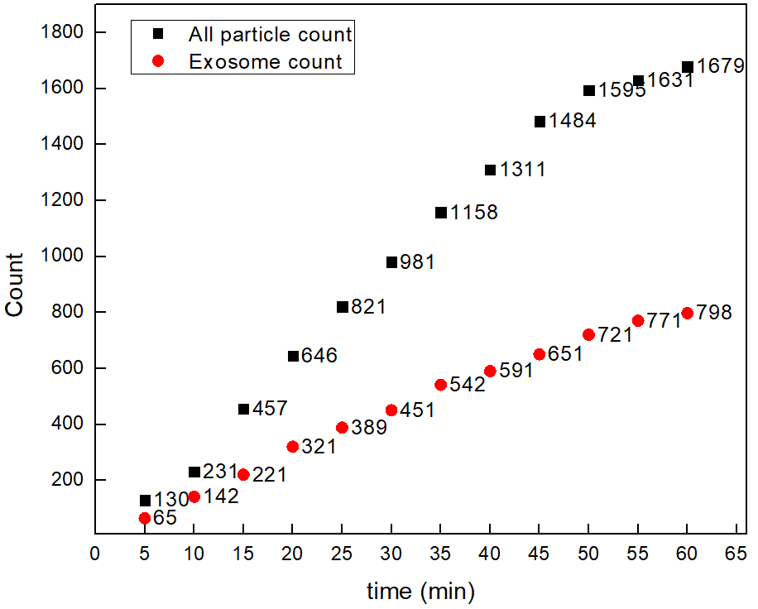
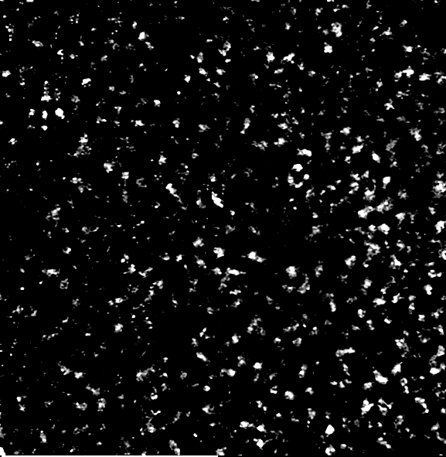

PANRORAMA of Plasma Sample 9 (similar to cancer plasma)
Time: 60 min
Count: 1679
Time: 60 min wash
Count: 171
Note: % of exosome have positive response to miRNA-21
Scale bar: 10 µm

Slide 15
Outline of plasma count after treatment
Sample | 1 | 2 12A | 3 | 4 | 5 24A | 6 | 7 | 9 745A
Before Wash | 1225 (684) | 1710 (793) | 32 (25) | 90 (56) | 1521 (758) | 59 (51) | 1205 (587) | 1679 (798)
After Wash | 428 | 293 | 11 | 7 | 431 | 12 | 314 | 171
Prediction | Cancer | Cancer (DEAD) | Healthy (ALIVE) | Healthy | Cancer (DEAD) | Healthy | Cancer | Cancer (ALIVE)

